Slide 1
UiPath-Based Validation of Blockchain Transactions for Transparent Logistics
Leveraging Robotic Process Automation for Automated, Trustworthy Supply Chain Verification
Course
Scope
Domain
Robotic Process Automation (RPA)
Automated blockchain-to-ERP transaction validation using UiPath bots
Logistics, Supply Chain, Blockchain, RPA
Presented By
Adithya Sankar Menon (23BRS1079)
Nitin Nandakumar (23BRS1378)
Date
Platform
18th August 2026
UiPath Studio + Orchestrator (Cloud)

Slide 2
Problem Statement
Modern logistics and supply chain networks involve dozens of intermediaries — manufacturers, freight forwarders, customs brokers, warehouses, and last-mile carriers. Each handoff generates transaction records, often on blockchain-based platforms (e.g., IBM Food Trust, VeChain, TradeLens) to ensure immutability and transparency. Yet the validation of these records remains overwhelmingly manual.
Manual Verification Bottleneck
Data Silos & Format Mismatch
Delayed Anomaly Detection
Logistics managers must manually cross-check blockchain transaction hashes, shipment IDs, timestamps, and smart contract events against internal ERP/WMS records. This is slow, error-prone, and does not scale.
Blockchain explorers output data in JSON/hex formats, while enterprise systems use CSV/Excel/SQL. Reconciling these requires tedious manual data transformation with no automated bridge.
Fraudulent or erroneous entries — tampered quantities, forged timestamps, unauthorized wallet addresses — go unnoticed for hours or days because no automated cross-validation exists.
Compliance & Audit Pressure
Scalability Crisis
Regulatory bodies (customs, food safety, pharma traceability) demand auditable proof that every blockchain-logged event was verified. Manual logs are legally insufficient.
As transaction volumes grow to thousands per day, human operators cannot keep pace, leading to verification backlogs and systemic trust erosion across the supply chain.
"In blockchain-enabled logistics ecosystems, the absence of automated, rule-based validation of on-chain transaction records against enterprise logistics systems leads to verification delays, undetected anomalies, compliance gaps, and a lack of real-time operational transparency."

Slide 3
Objectives
Primary Objective: To design and implement a UiPath RPA bot that automatically validates blockchain transaction records against logistics enterprise data, ensuring real-time transparency, anomaly detection, and audit-ready compliance.
1
2
Automate Data Extraction
Cross-System Reconciliation
Build UiPath workflows to extract blockchain transaction data — transaction hash, block number, timestamp, sender/receiver addresses, payload — from blockchain explorer web portals or REST APIs.
Develop automated comparison logic between blockchain records and internal logistics data (shipment IDs, quantities, delivery timestamps) stored in Excel/CSV/ERP systems.
3
4
Rule-Based Validation Engine
Anomaly Flagging & Alerting
Implement configurable validation rules within UiPath: timestamp consistency, quantity matching, wallet/address whitelisting, and smart contract event verification.
Automatically flag mismatches, generate exception reports, and trigger email/Teams/Slack alerts to logistics managers when anomalies are detected.
5
6
Audit Trail Generation
Dashboard Reporting
Produce timestamped validation logs (PDF/Excel) that serve as compliance evidence for regulatory audits — customs, food safety, pharma traceability.
Generate a summary validation dashboard showing pass/fail rates, anomaly trends, and processing times for operational visibility.

Slide 4
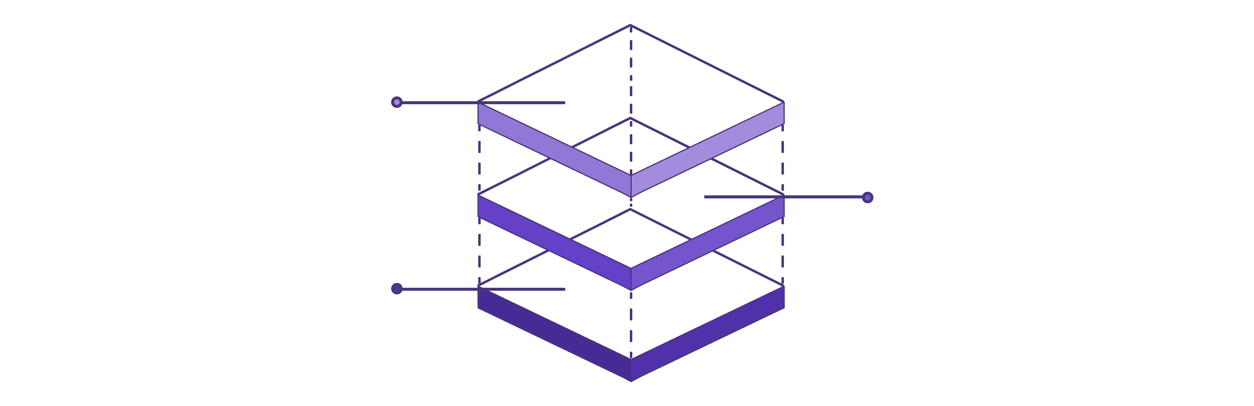
System Architecture (High-Level)
Outputs
Blockchain, ERP/Excel, reports & alerts
Studio Bot
Data extraction, validation, reporting
Orchestrator
Scheduling, monitoring, centralized logs
Layer 1 — Orchestration
Layer 2 — Bot Core
Layer 3 — Data & Output
UiPath Orchestrator (Cloud)
Scheduling & triggers
Execution monitoring
Centralized logs
Data Extraction Module
Preprocessing & Mapping
Validation Engine
Reporting Module
Blockchain Explorer / API
Logistics ERP / Excel / SQL
Excel & PDF Reports
Email / Teams Alerts

Slide 5
Phase 1 & 2 — Data Acquisition & Preprocessing
Blockchain Data Extraction
Phase 2 — Preprocessing & Mapping
Timestamp Normalization
Option A — Web Scraping
Option B — API Integration
Convert blockchain Unix timestamps to human-readable DateTime using DateTime.ParseExact or epoch.AddSeconds() in UiPath's Invoke Code activity.
UiPath Browser Automation navigates a blockchain explorer (Etherscan, BscScan, Hyperledger Explorer UI). Data Scraping Wizard extracts transaction tables: TxHash, Block, Timestamp, From, To, Value, Input Data.
HTTP Request activity calls blockchain explorer REST APIs (e.g., api.etherscan.io/api?module=account&action=txlist&address=0x...). JSON response parsed via Deserialize JSON activity.
Address Standardization
Normalize blockchain addresses to lowercase to reconcile checksummed vs. non-checksummed address formats across systems.
Extracted data stored in a DataTable variable within UiPath for downstream processing.
Field Mapping
Mapping table links blockchain TxHash → ShipmentID using a lookup key embedded in the transaction's input data or a separate mapping configuration file.
Logistics System Extraction
Excel Application Scope / Read Range loads shipment records: ShipmentID, ExpectedQty, DispatchTimestamp, ReceiverAddress, PONumber. Database Connect activity used for ERP/SQL-based systems. Stored in a second DataTable.

Slide 6
Phase 3 — Validation Engine (Core Logic)
Implemented using If/Else, Switch, and For Each Row activities in UiPath. Each blockchain DataTable row is processed and assigned a ValidationStatus: PASS, FAIL, or WARNING. Failed records are appended to an Exceptions DataTable with the failure reason.
Validation Rule
Logic / Condition
Flag Trigger
Timestamp Check
|Blockchain Timestamp − ERP Timestamp| ≤ Tolerance (2 hrs)
If Math.Abs(DateDiff("h", bcTime, erpTime)) > 2 Then Flag
Quantity Match
On-chain value = Expected Qty from Purchase Order
If bcQty <> erpQty Then Flag
Address Whitelist
Sender/Receiver address ∈ Approved Partners List
If Not approvedList.Contains(bcAddress) Then Flag
Duplicate Detection
No duplicate TxHash for same ShipmentID
If dtResults.Select("TxHash='" + hash + "'").Length > 1 Then Flag
Sequence Validation
Events follow expected order: Dispatched → InTransit → Delivered
State machine or ordered enum comparison against expected sequence
Smart Contract Event
Expected event (e.g., GoodsReceived) was emitted
Check Input Data / Logs field for event signature hash

Slide 7
Phase 4 & 5 — Reporting, Alerting & Orchestration
Phase 4 — Reporting & Alerting
Phase 5 — Scheduling & Orchestration
Validation Report (Excel)
01
Write Range outputs results to a styled Excel report with conditional formatting: green = PASS, red = FAIL, yellow = WARNING.
Deploy to Orchestrator
Publish the UiPath bot package to UiPath Orchestrator (Cloud) for centralized management.
PDF Audit Log
Export to PDF generates a formal audit document with timestamps, bot ID, and full validation results — suitable for regulatory submission.
02
Schedule Triggers
Email Alerts
Configure time-based triggers — e.g., every 4 hours or daily at 6 AM — for continuous validation cycles.
Send SMTP Mail / Send Outlook Mail notifies stakeholders when anomalies are detected. Email body includes a summary table of all failed validations.
03
Queue-Based Processing
Optional Dashboard
For high-volume scenarios, each blockchain transaction becomes an Orchestrator Queue item processed by the bot in parallel.
Summary stats (total validated, pass %, fail %, top anomaly types) pushed to Google Sheets or Power BI dataset via API for real-time visibility.
04
Monitor & Audit
Orchestrator Dashboard provides execution logs, success rates, and bot uptime metrics for operational oversight.

Slide 8
Novelty — Automated RPA-Blockchain Bridge
Most existing blockchain validation solutions require custom software development (Python scripts, Node.js backends) or expensive middleware platforms. This project introduces a no-code/low-code RPA approach using UiPath that democratizes blockchain validation for business operations teams.
Novelty 1 — Democratized Validation via RPA
Novelty 2 — Human-in-the-Loop Escalation
Non-technical logistics managers can configure and run validation bots without writing code. Validation rules are stored in an external Excel config file, making the system adaptable without modifying the UiPath workflow. A first-of-its-kind approach bridging blockchain technology and business operations teams.
Unlike fully automated scripts that silently log errors, this bot implements an Attended Automation escalation model: when a high-severity anomaly is detected (e.g., unauthorized wallet address), the bot pauses, displays an interactive UiPath Form to the operator for manual review, and resumes based on human decision. A novel RPA design pattern in the blockchain-logistics domain.
Novelty 3 — Cross-Platform Blockchain Agnosticism
Novelty 4 — Audit-First Self-Validating Logs
The bot validates transactions from any blockchain (Ethereum, Hyperledger, Polygon, etc.) by simply changing the API endpoint and field mappings in the config — no workflow redesign needed. This plug-and-play adaptability is a novelty over hardcoded validation scripts.
Every validation action is logged with bot identity, timestamp, input data hash, and result. The audit log includes a hash of the previous log entry, forming a mini chain-of-custody for the verification process itself — creating a tamper-evident audit trail of the validation process.

Slide 9
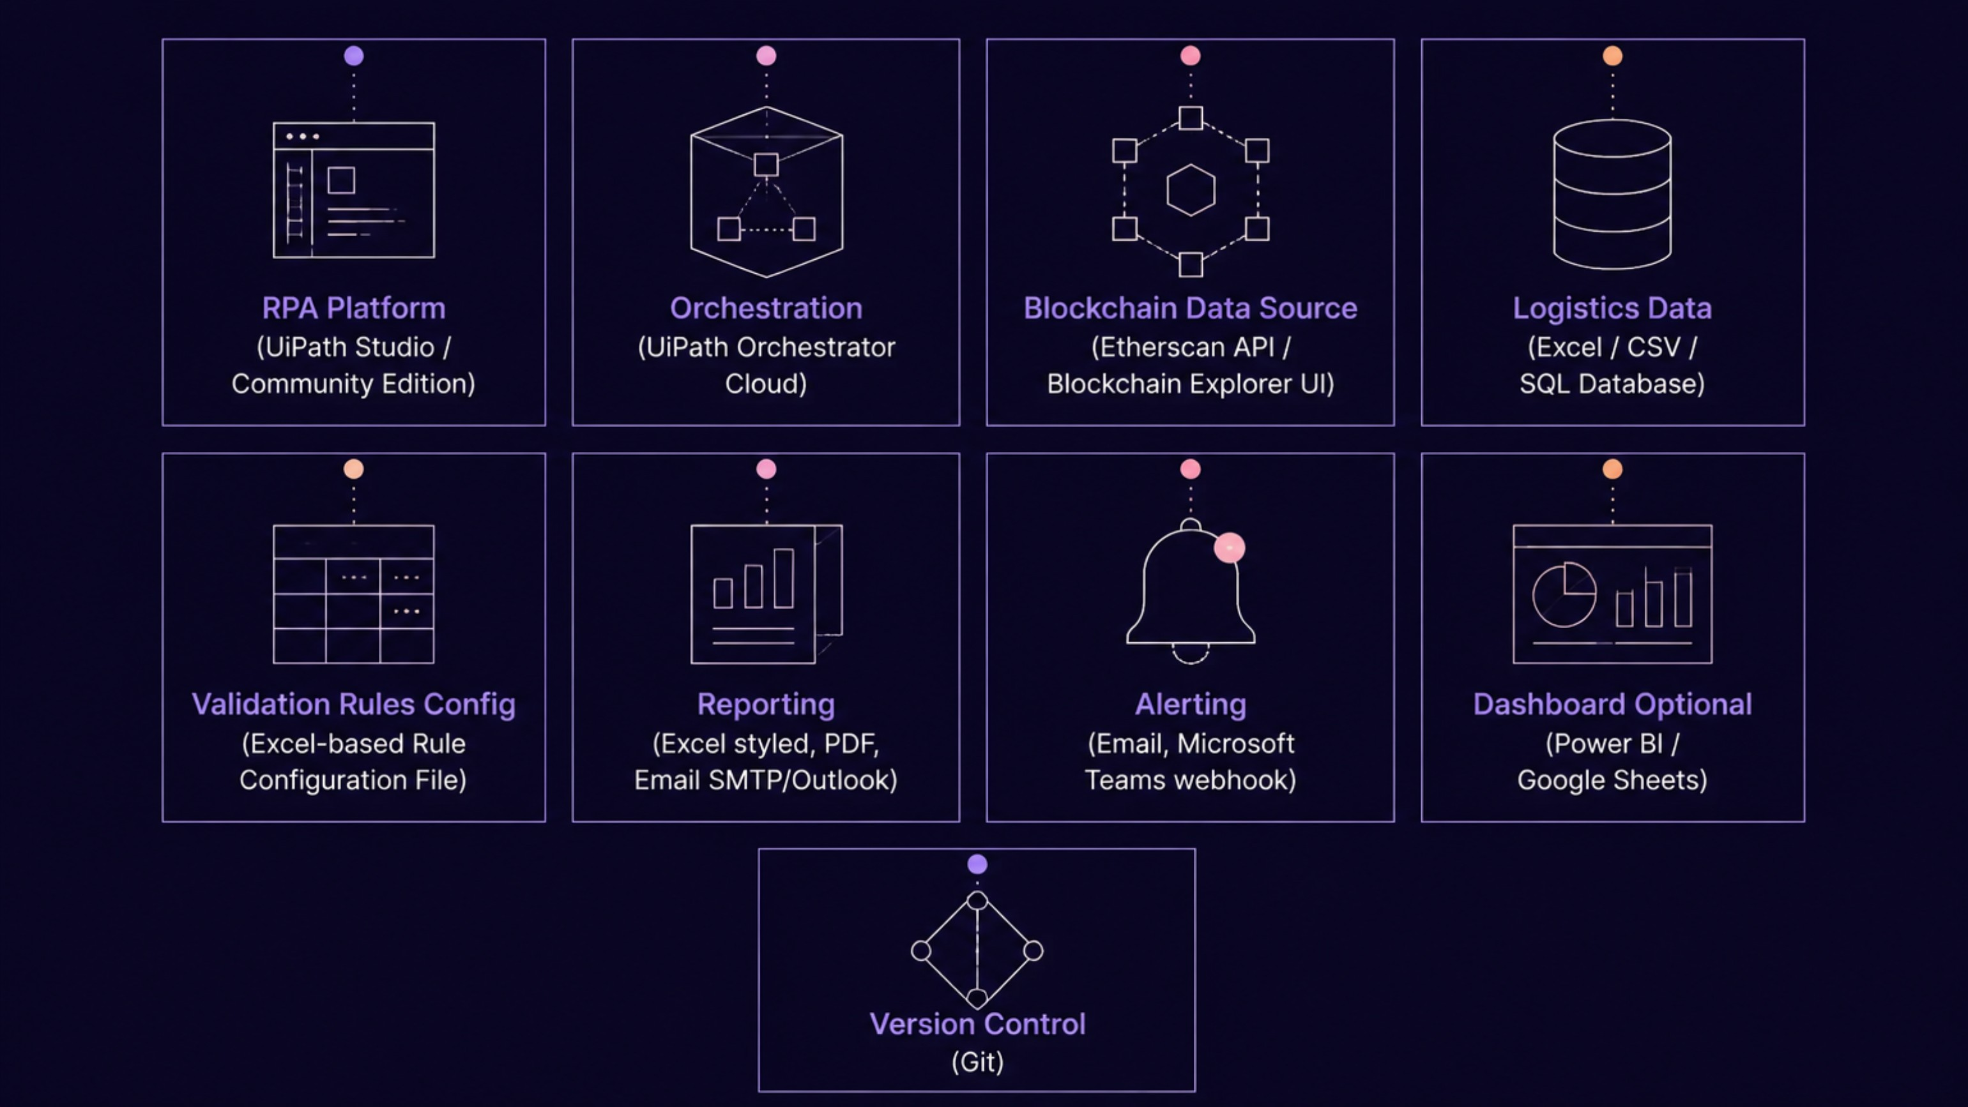
Technology Stack
Core Platform Components
Output & Integration Components
Component
Technology
Component
Technology
RPA Platform
UiPath Studio / Community Edition
Reporting
Excel (styled), PDF, Email (SMTP/Outlook)
Orchestration
UiPath Orchestrator (Cloud)
Alerting
Email, Microsoft Teams (optional webhook)
Blockchain Source
Etherscan API / Blockchain Explorer UI
Dashboard (Optional)
Power BI / Google Sheets
Logistics Data
Excel / CSV / SQL Database
Version Control
Git
Rules Config
Excel-based Rule Configuration File

Slide 10

Summary & Conclusion
This project presents a comprehensive UiPath RPA solution that bridges the gap between immutable blockchain transaction records and enterprise logistics systems — delivering automated validation, real-time anomaly detection, and audit-ready compliance at scale.
What This System Delivers
Future Scope
Automated Blockchain-to-ERP Reconciliation
01
Six-rule validation engine processes every transaction: timestamp, quantity, whitelist, duplicate, sequence, and smart contract event checks — with PASS/FAIL/WARNING status per record.
ML-Based Anomaly Detection
Integrate UiPath AI Center with ML models trained on historical transaction patterns to detect novel fraud signatures beyond rule-based logic.
No-Code, Blockchain-Agnostic Architecture
Excel-based rule configuration and plug-and-play API endpoints enable non-technical teams to operate and adapt the bot across Ethereum, Hyperledger, Polygon, and any future blockchain platform.
02
Smart Contract Auto-Remediation
Tamper-Evident Audit Trail
Extend the bot to trigger corrective smart contract calls when specific, pre-approved anomaly types are detected — closing the loop fully.
Self-validating logs with chained entry hashes create a chain-of-custody for the verification process itself — satisfying customs, food safety, and pharma traceability regulatory requirements.
03
Scalable Orchestration
Multi-Chain Support
UiPath Orchestrator queue-based processing handles thousands of daily transactions with scheduled triggers, uptime monitoring, and centralized execution logs.
Expand config-driven API switching to simultaneously validate transactions across multiple blockchain networks in a single bot run.
04
Real-Time Streaming
Replace scheduled polling with event-driven triggers using blockchain WebSocket subscriptions for sub-second validation latency.
Target: 90%+ reduction in manual verification effort with full regulatory audit coverage.

Slide 11
Implementation Methodology & Phases
A 14-week delivery plan for building, validating, and deploying the automation solution.
Week
Phase
Activities
Deliverable
1–2
Research & Planning
Define scope, success criteria, data sources, rule categories, and implementation architecture.
Project plan, requirements brief, and solution design outline.
3–4
Data Acquisition Module
Build blockchain extraction via API/web access and logistics data ingestion from Excel/SQL sources.
Working ingestion workflow and normalized DataTables.
5–6
Preprocessing & Mapping
Normalize timestamps, standardize addresses, and map TxHash to ShipmentID using configuration files.
Preprocessing logic and mapping configuration layer.
7–9
Validation Engine
Implement six rule-based checks for timestamp, quantity, whitelist, duplicate, sequence, and smart contract events.
Validation engine with PASS / FAIL / WARNING outcomes.
10–11
Reporting & Alerting
Generate styled Excel and PDF outputs, audit logs, email alerts, and optional dashboard updates.
Reporting pack, alerting workflow, and audit-ready outputs.
12
Integration & Orchestrator
Deploy to UiPath Orchestrator, configure schedules, queue processing, and monitoring hooks.
Deployed automated workflow in Orchestrator.
13
Testing & Refinement
Run functional tests, resolve exceptions, tune rules, and validate end-to-end results.
Stabilized release candidate with test sign-off.
14
Documentation & Presentation
Finalize user guide, technical documentation, handover notes, and presentation materials.
Complete documentation set and final project presentation.
14-Week Gantt View
Weeks 1–2
Weeks 3–4
Research & Planning
Data Acquisition Module
Weeks 5–6
Weeks 7–9
Preprocessing & Mapping
Validation Engine
Weeks 10–11
Week 12
Reporting & Alerting
Integration & Orchestrator
Week 13
Week 14
Testing & Refinement
Documentation & Presentation

Slide 12
Expected Outcomes
1
90%+ reduction in manual blockchain verification effort
2
Real-time anomaly detection within minutes of transaction recording
3
Audit-ready compliance reports generated automatically
4
Configurable, reusable bot adaptable to any blockchain-logistics scenario
5
Scalable architecture via UiPath Orchestrator queues for enterprise volumes

Slide 13

Future Scope
01
02
Integration with AI/ML models in UiPath (via ML Skills) for predictive anomaly detection
IoT data fusion — validate blockchain records against IoT sensor data (temperature, GPS)
03
04
Multi-chain support — simultaneous validation across multiple blockchain networks
Natural Language Reporting — use UiPath + GenAI to auto-generate narrative audit reports
05
Smart Contract Auto-Remediation — trigger corrective smart contract calls when anomalies are confirmed

Slide 14
References
UiPath Official Documentation — docs.uipath.com
Etherscan API Documentation — docs.etherscan.io
Nakamoto, S. (2008). Bitcoin: A Peer-to-Peer Electronic Cash System
Kshetri, N. (2018). "Blockchain's roles in meeting key supply chain management objectives." International Journal of Information Management, 39, 80–89.
van der Aalst, W. M. P., Bichler, M., & Heinzl, A. (2018). "Robotic Process Automation." Business & Information Systems Engineering, 60(4), 269–272.
IBM Food Trust — ibm.com/food
TradeLens by Maersk & IBM — tradelens.com
Casino, F., Dasaklis, T. K., & Patsakis, C. (2019). "A systematic literature review of blockchain-based applications." Telematics and Informatics, 36, 55–81.

